Slide 1
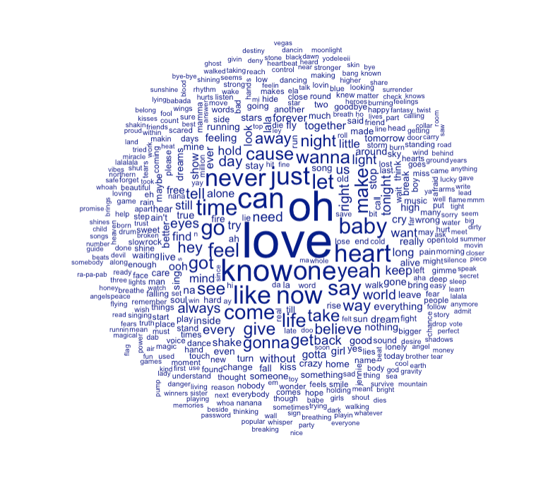

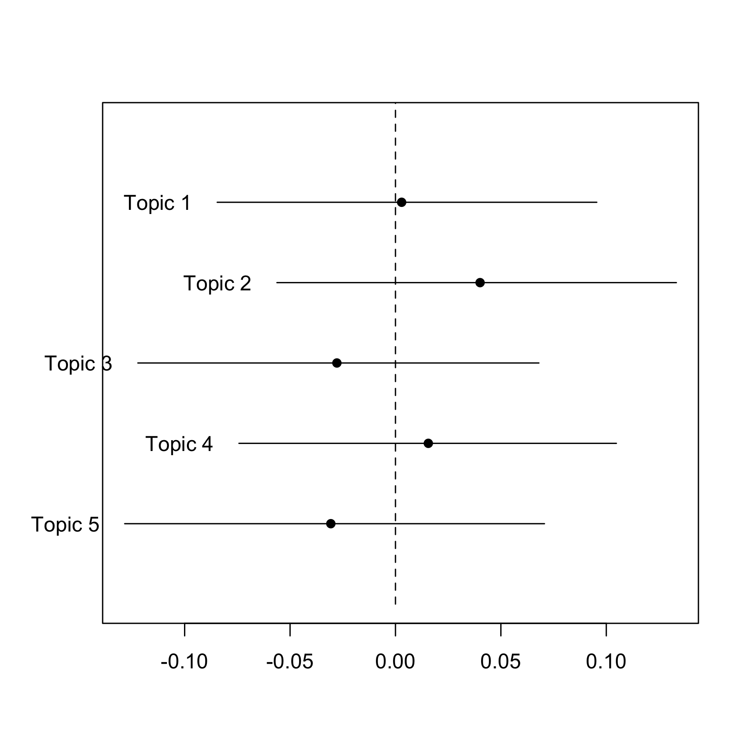



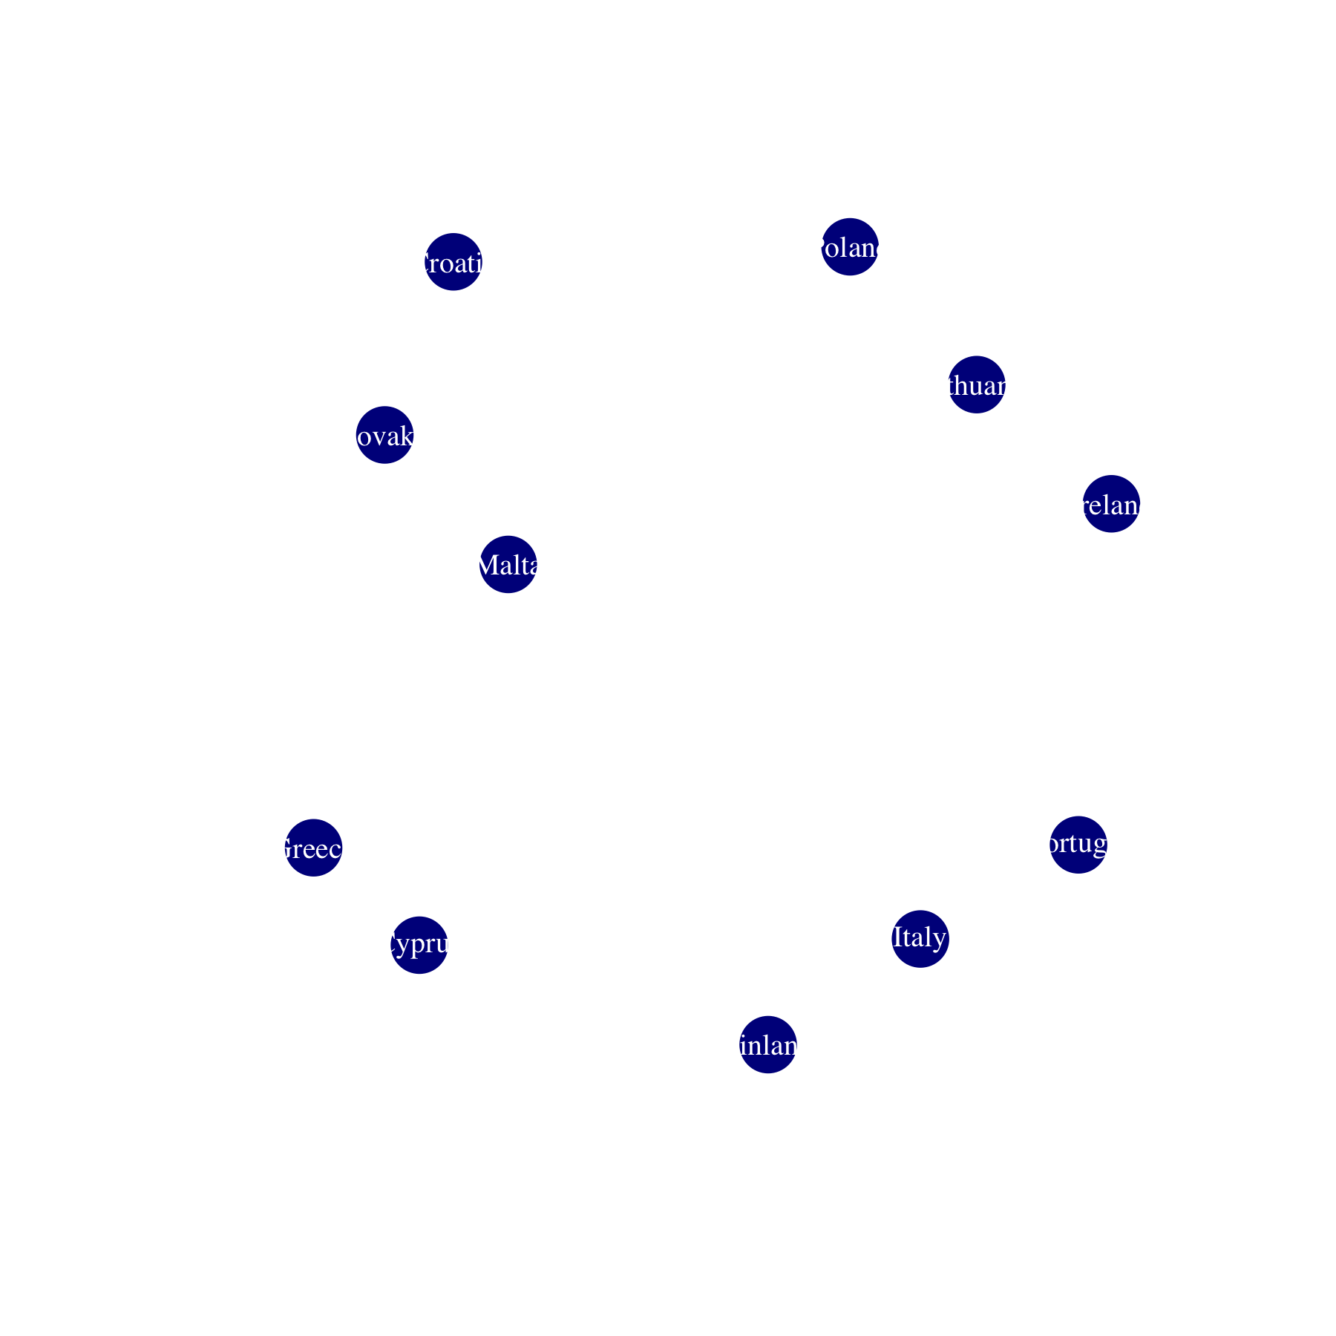

Political voting is alive and well in Eurovision.
Non-Cognitive Predictors of Student Success: A Predictive Validity Comparison Between Domestic and International Students
Non-Cognitive Predictors of Student Success: A Predictive Validity Comparison Between Domestic and International Students
When Sweden Gets Twelve Points From Norway, It’s Clearly Just Good Taste: The Predictors of Eurovision Success
Lauren Gilbert
INTRO
Eurovision is an annual song contest of mostly-European countries, watched by hundreds of millions of people
It is widely perceived to be more about politics than song
Commentators frequently note that countries vote for their political allies or neighbors
LITERATURE
There is an existing literature on Eurovision voting, but it is almost exclusively about the pre-televote era. Prior to 1998, voting was conducted by a small jury; now the popular vote determines half the points awarded. It is entirely plausible that the jury vote and televote would show different patterns, and thus, it is time for an update.
METHODS
Constructed database of all Eurovision votes 1975-2019
First Eurovision data set to include song lyrics
Also included political/geographic information
QUESTIONS
Do countries vote for their neighbors or political allies?
Is block voting common?
Is it an advantage to sing in English?
Does the song content matter?
NETWORKS
This chart shows countries that, on average, give at least 15.5% of their vote total to another country (including only dyads that appear at least five times)
Over the entire sample set, there are clear geographic trends – there is a “eastern Europe” voting block (mostly former Warsaw Pact countries) and a “southern Europe/Balkan” voting block
Voting networks have developed over time
SONG CONTENT
Song content provides no predictive power whatsoever
Supervised learning is unable to predict top five finishers, and unsupervised learning cannot discover any significant categories
The categories it does identity do not seem to have any thematic connection.
From left to right: dyads that gave each other at least 15.5% of their vote in the 1980s, 1990s, 2000s, and 2010s
(excluding dyads that appeared just once)
SCORE PREDICTION REGRESSION
Singing in English increases your average points received by about 1%.
However, this effect is driven by juries only; televoters actually like songs in English less.
Going later in the running order increases your predicted score.
In general, there is no significant differences between jury and televote in a given dyad.
When country fixed effects are included, distance between countries has no impact on score – suggesting simple diffusion is not the process involved, and politics matter.
NEURAL NETWORK
I trained a neural network to write Eurovision songs. Here are some sample lyrics:
“I can see you what you want”
“ I got the beat, I see the stars”
“I will never let you go on the sun”
“The heart is a million sorrow”
“Love is a start.”
REAL EUROVISION LYRICS
“We are made of stars.”
“Hey now, if you let me drown I’ll swim like a champion”
“On a dark deserted way say na na na”
“Oh Europe, where oh where did it all go wrong?”
PARTICULARLY DISLIKED DYADS
Dyads that are likely to vote for each other are shown above. Some dyads particularly dislike each other, though.
Greece dislikes most of its neighbors (except Cyprus); they are particularly unlikely to vote for Italy, Montenegro, Turkey and (North) Macedonia.
“Grudges” are particularly common in southern Europe; relatively few northern European countries have highly negative dyad fixed effects.
The United Kingdom is not particularly disliked (over the full data set).
Muslim countries (Turkey, Morocco) are particularly disliked, suggesting cultural voting.
Notes:
Notes:
In Powerpoint, click View > Guides
Keep text within gutter guides.
Author list: Don’t split names onto two lines (e.g., “Jimmy [break] Smith”). If that happens, use a new line, unless you need the space. Bold the first names of anybody who’s presenting in person.
Intro/methods/result: Do not drop below font size 28, but if you have extra space, jack up the font size until the space is full.
Do not use color in the sidebars except in graphs/figures. It’ll pull attention from the center and slow interpretation for passersby.

